Slide 1


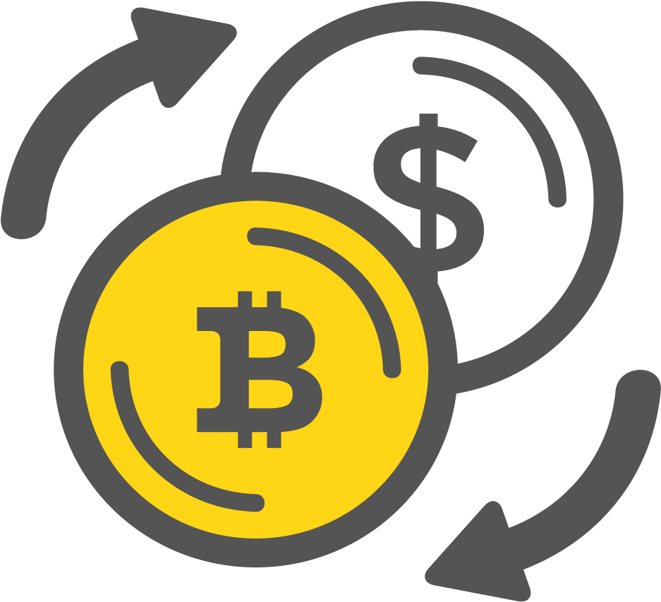
Arbitrage system for cryptocurrency
Winter 2018/2019

Slide 2
Supervision: Mr. Mark Levin
Students: Ameer Saleh
Muhammad Abu Yonis

Slide 3
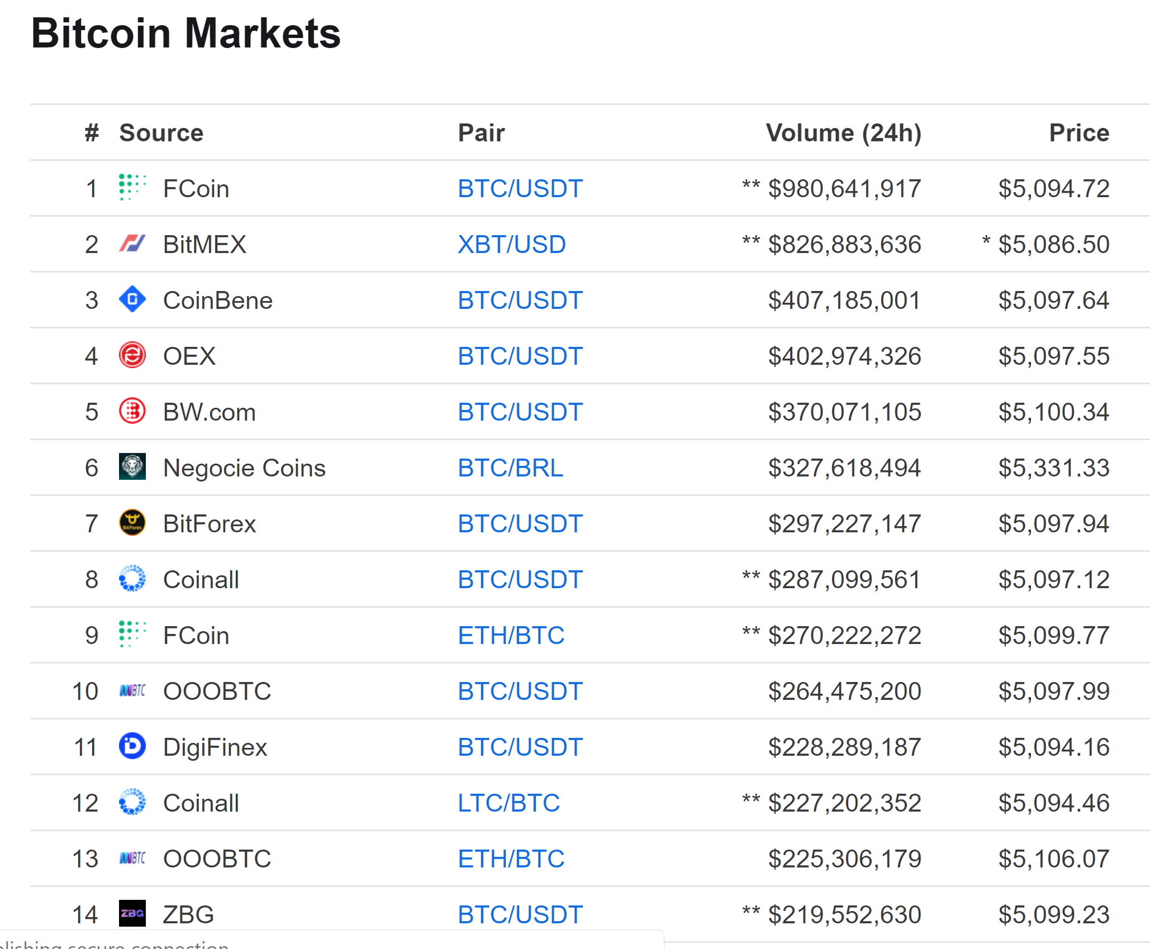
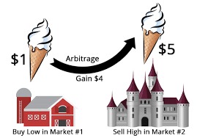
Why arbitrage?

Slide 4
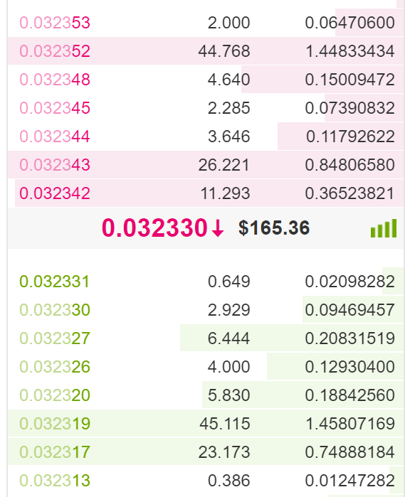
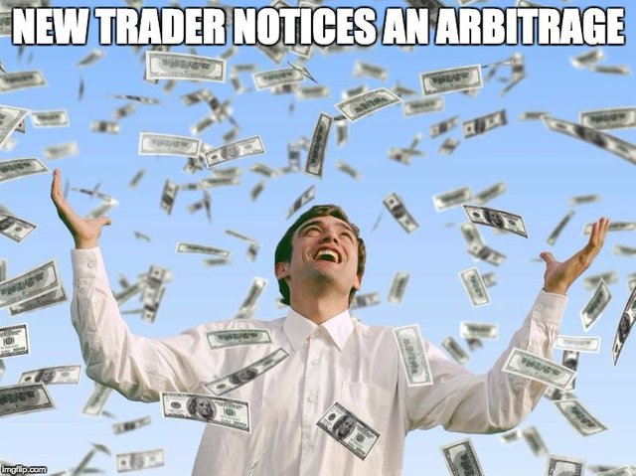
Background
ETH/BTC orderbook
New inefficient market.
Traders bid on/ask for price.
No “whales” controlling market.

Slide 5
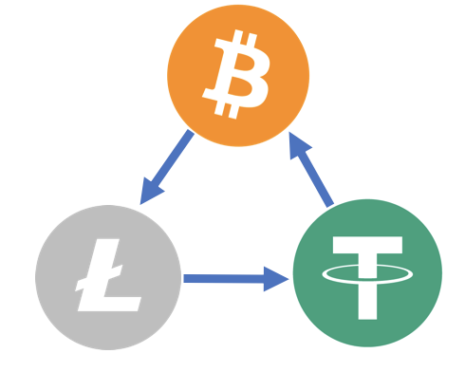
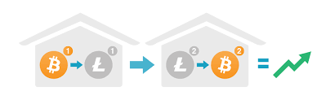
Two types of Arbitrage
Triangular in-exchange
Cross exchange

Slide 6
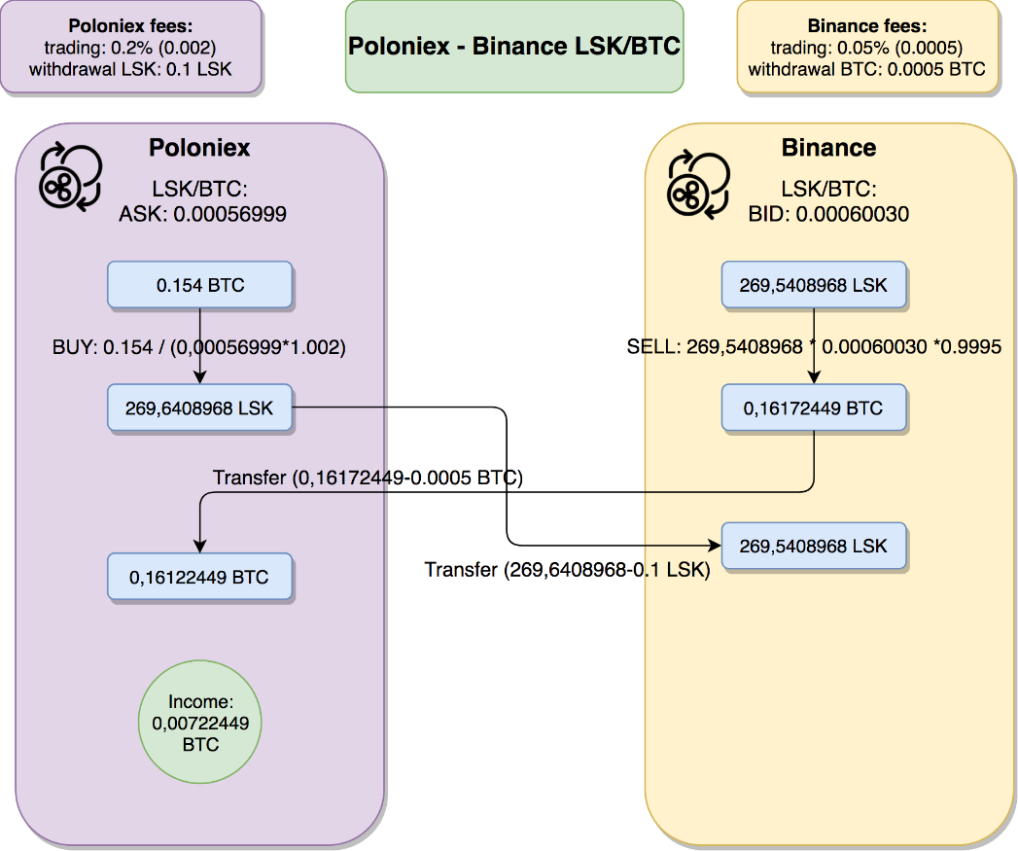
Related work – Parallel arbitrage
+ Immediate, low risk
- Must spread assets

Slide 7
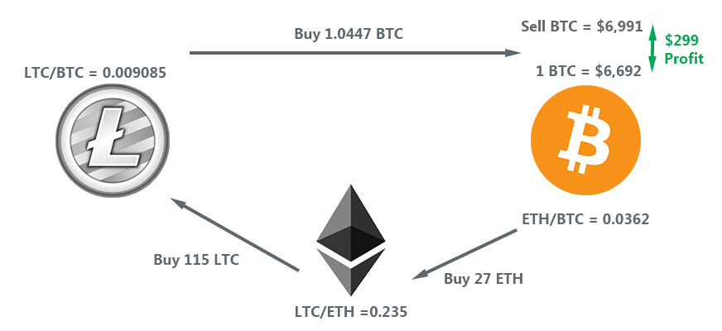
Triangular arbitrage
Sell cryptocurrency 1 and buy cryptocurrency 2
Sell cryptocurrency 2 and buy cryptocurrency 3
Sell cryptocurrency 3 for cryptocurrency 1
Withdraw the profit

Slide 8
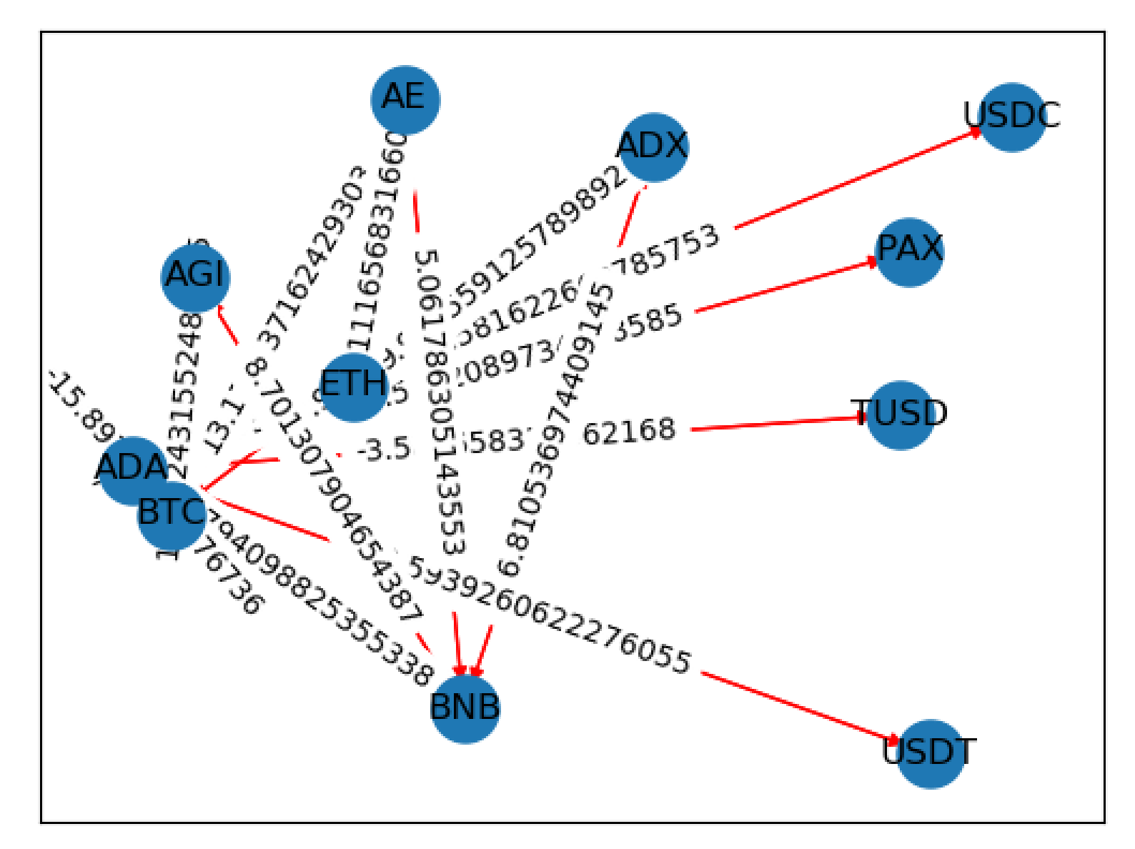
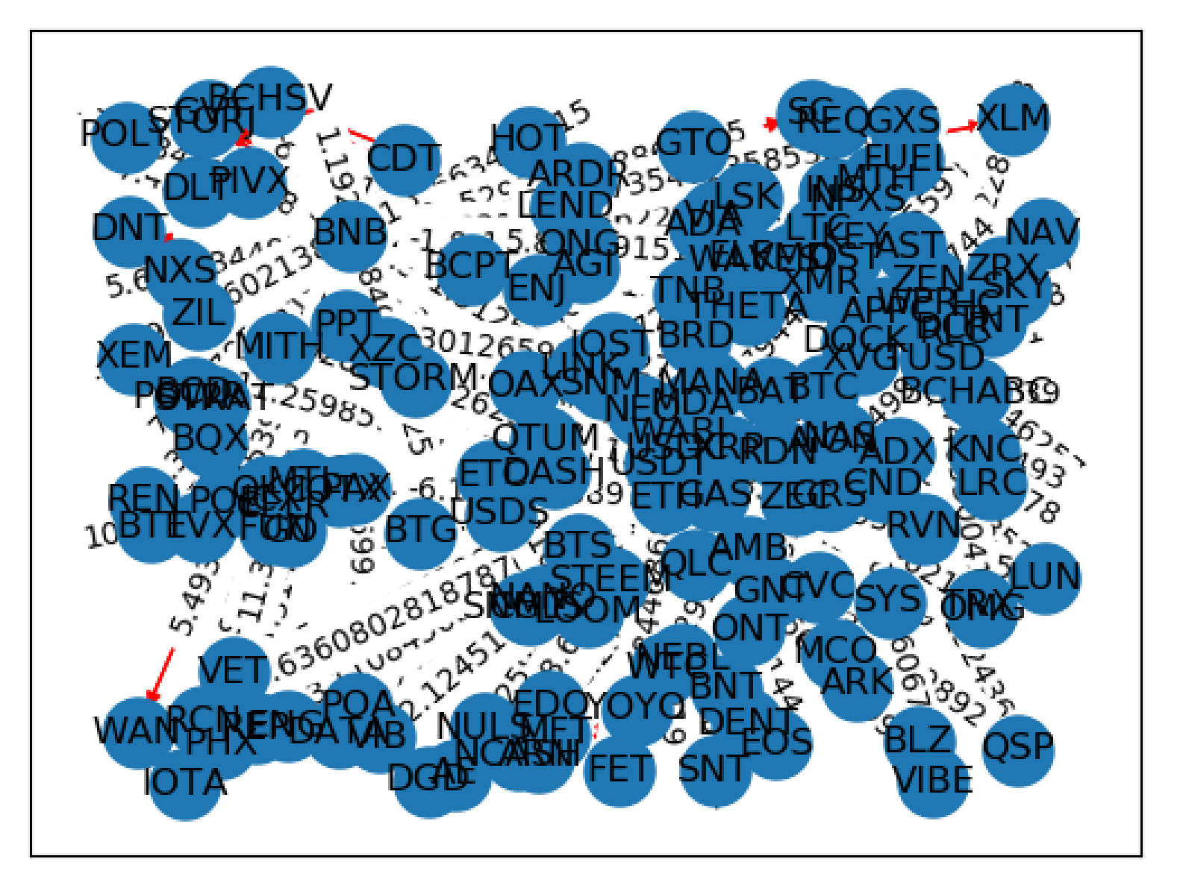
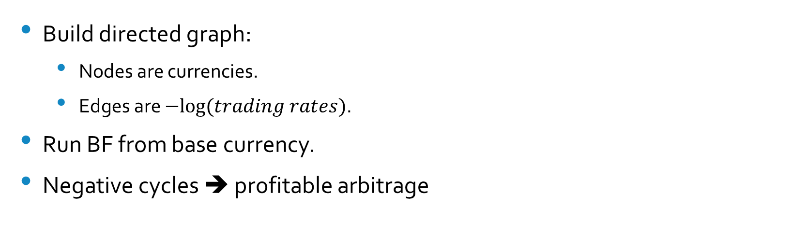
Bellman Ford graph – generic algorithm
15 currencies
Build directed graph:
Nodes are currencies.
Edges are $−log⁡(trading rates)$.
Run BF from base currency.
Negative cycles ➔ profitable arbitrage
All currencies

Slide 9
Triangular market matching algorithm
Currencies usually trade in different markets:
EOS/BTC, EOS/ETH, EOS/USDT
Most in-exchange arbitrages are imbalances in markets.
Our algorithm exploits these opportunities
EOS/BTC – EOS/ETH – ETH/BTC
EOS/BTC
ETH/BTC
EOS/ETH

Slide 10
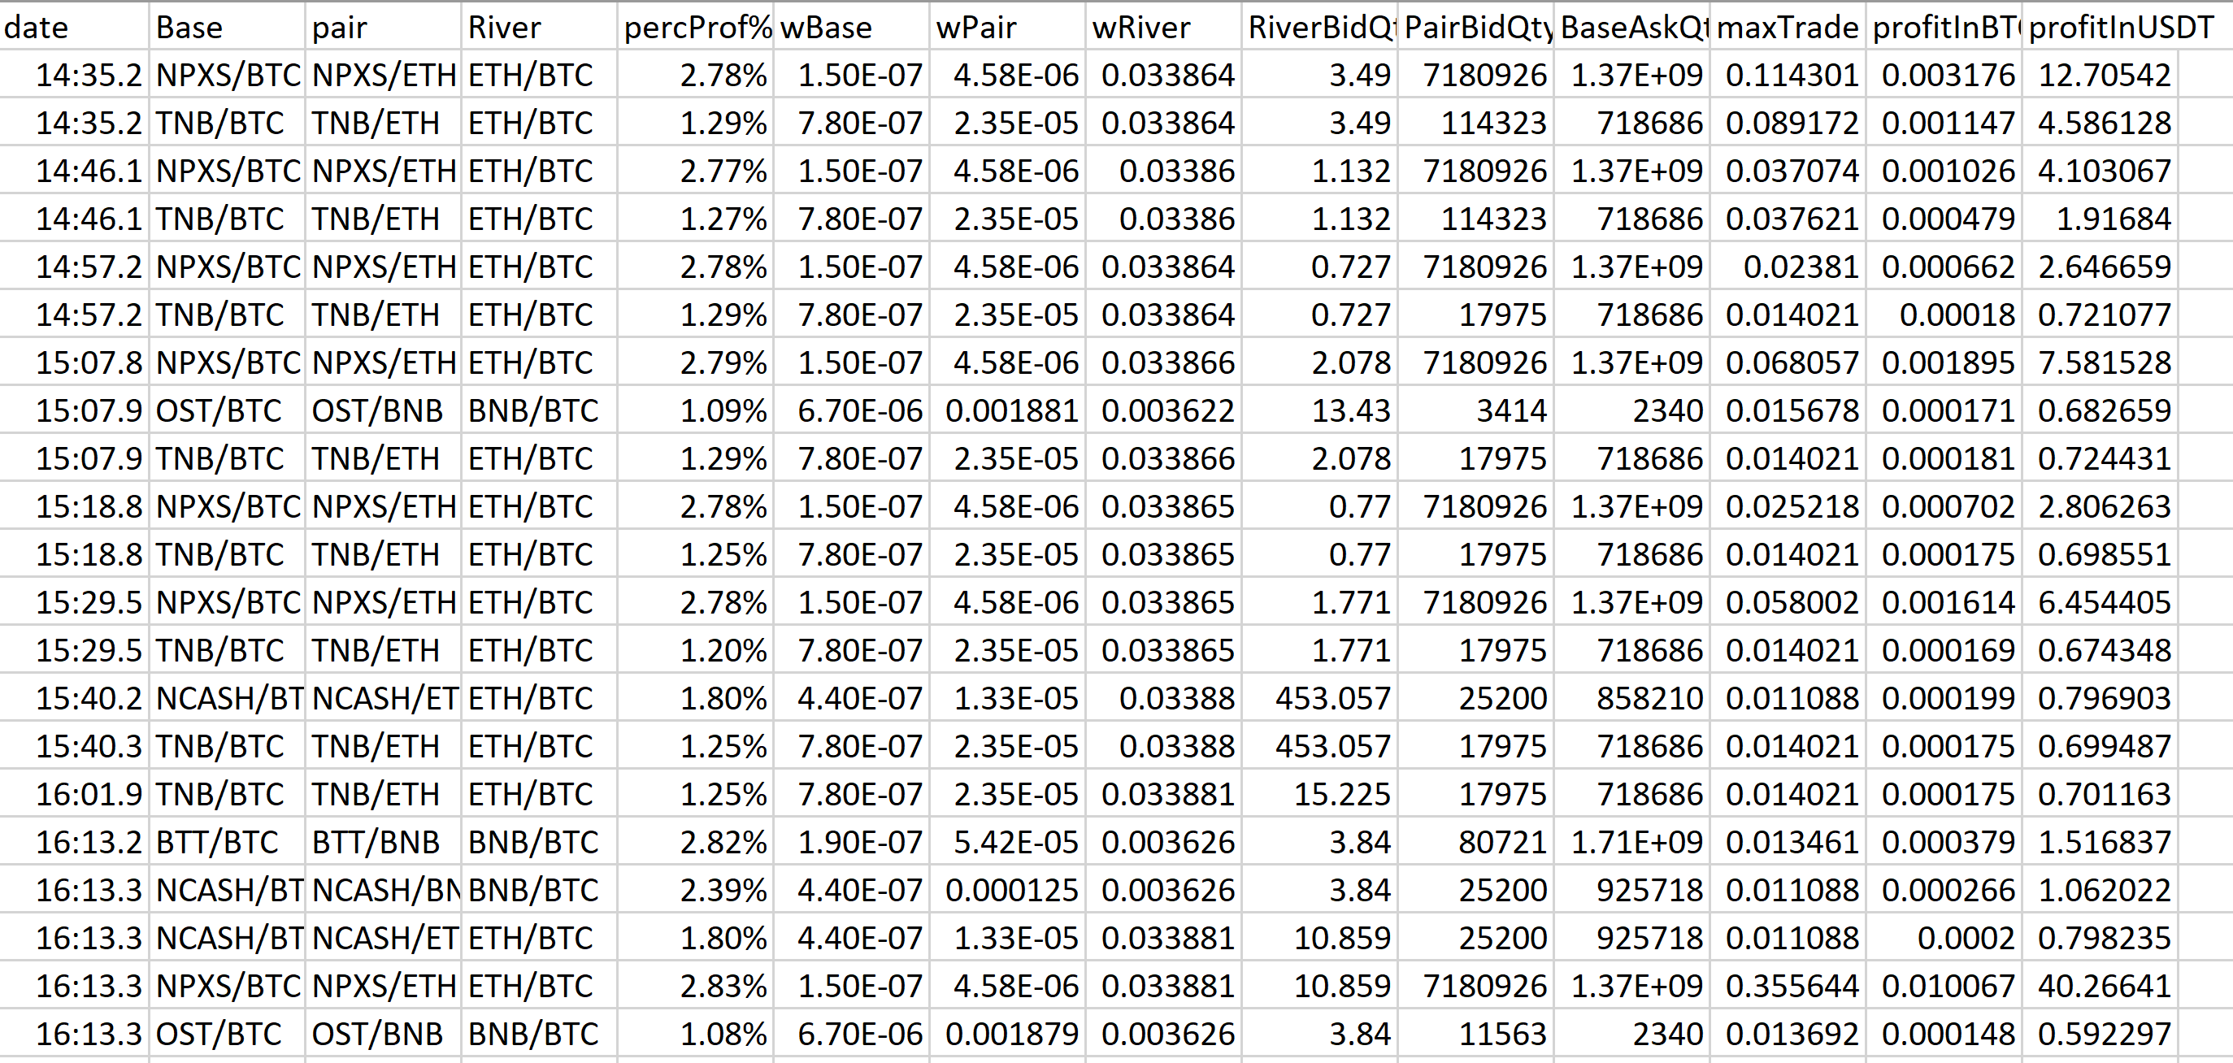

Simulation

Slide 11
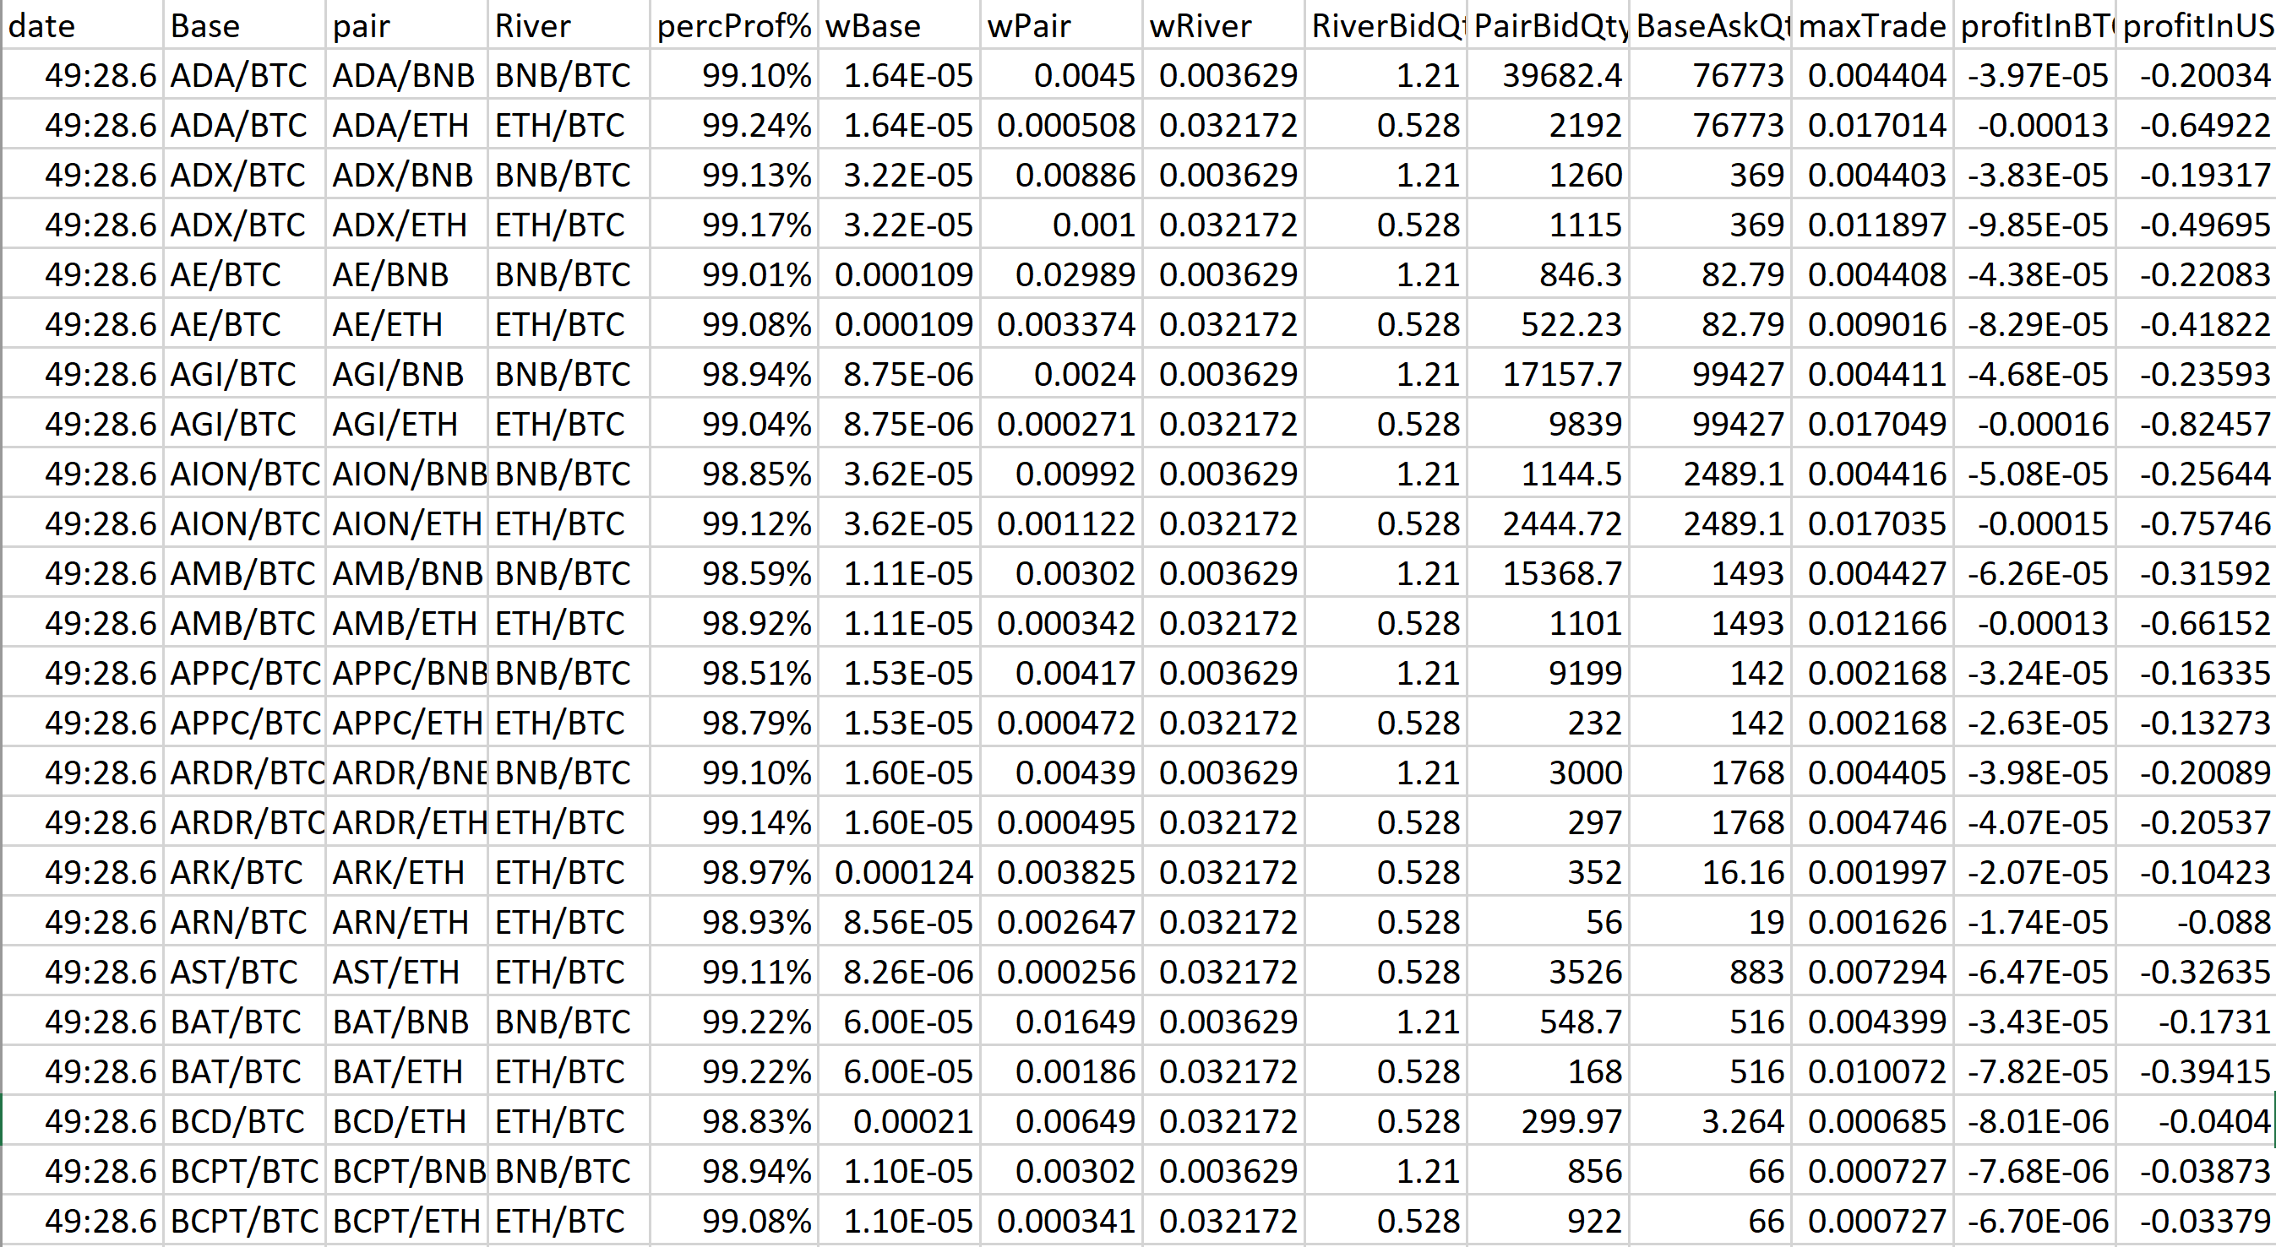

Fees? asks and bids?

Slide 12
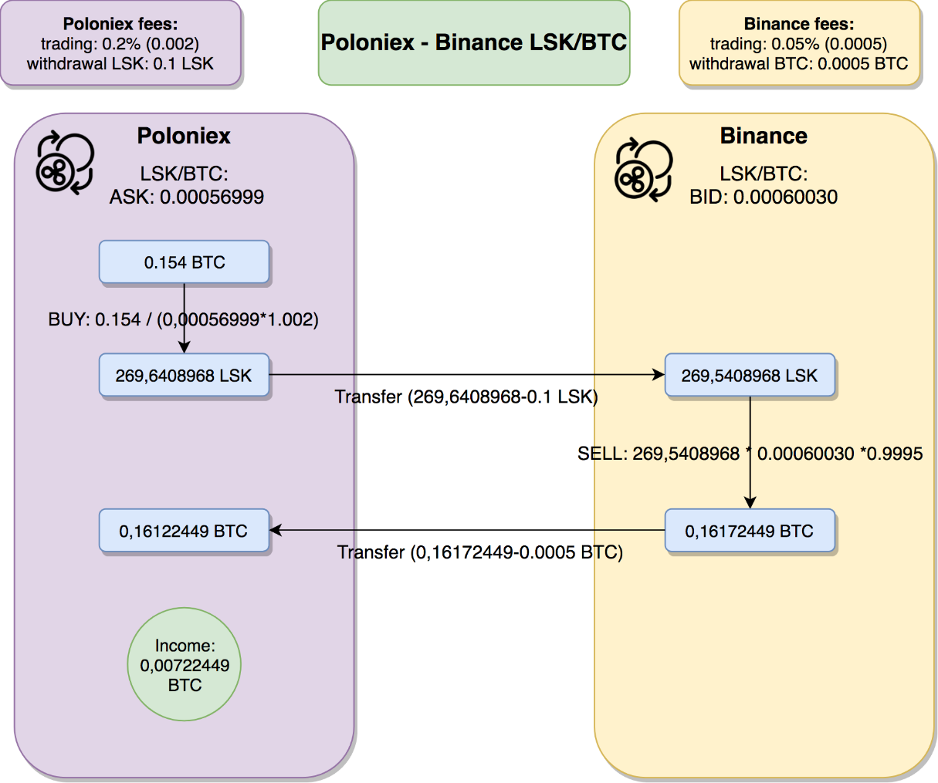
Cross exchange arbitrage
Buy lowest ask price, sell highest bid price
At E1, set a buy market order for C.
Transfer the C coins to E2.
At E2, set a sell market order for C.
Withdraw from E2 and deposit into E1
Key reasons:
Liquidity matters.
Geography, exchange origin.
New coin Listings.

Slide 13
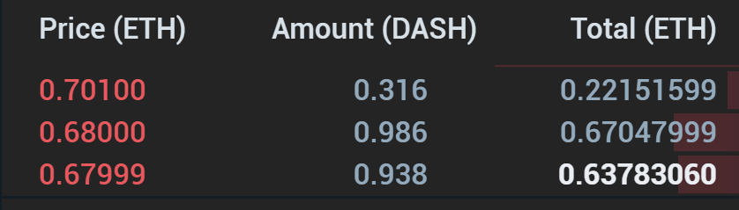
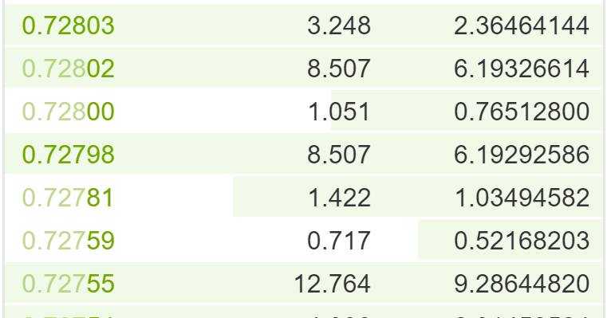
Result example:
Over 24H period our system found 3242 cross exchange arbitrage opportunities!
Dash ask book at Coss
Dash bid book at Binance

Slide 14
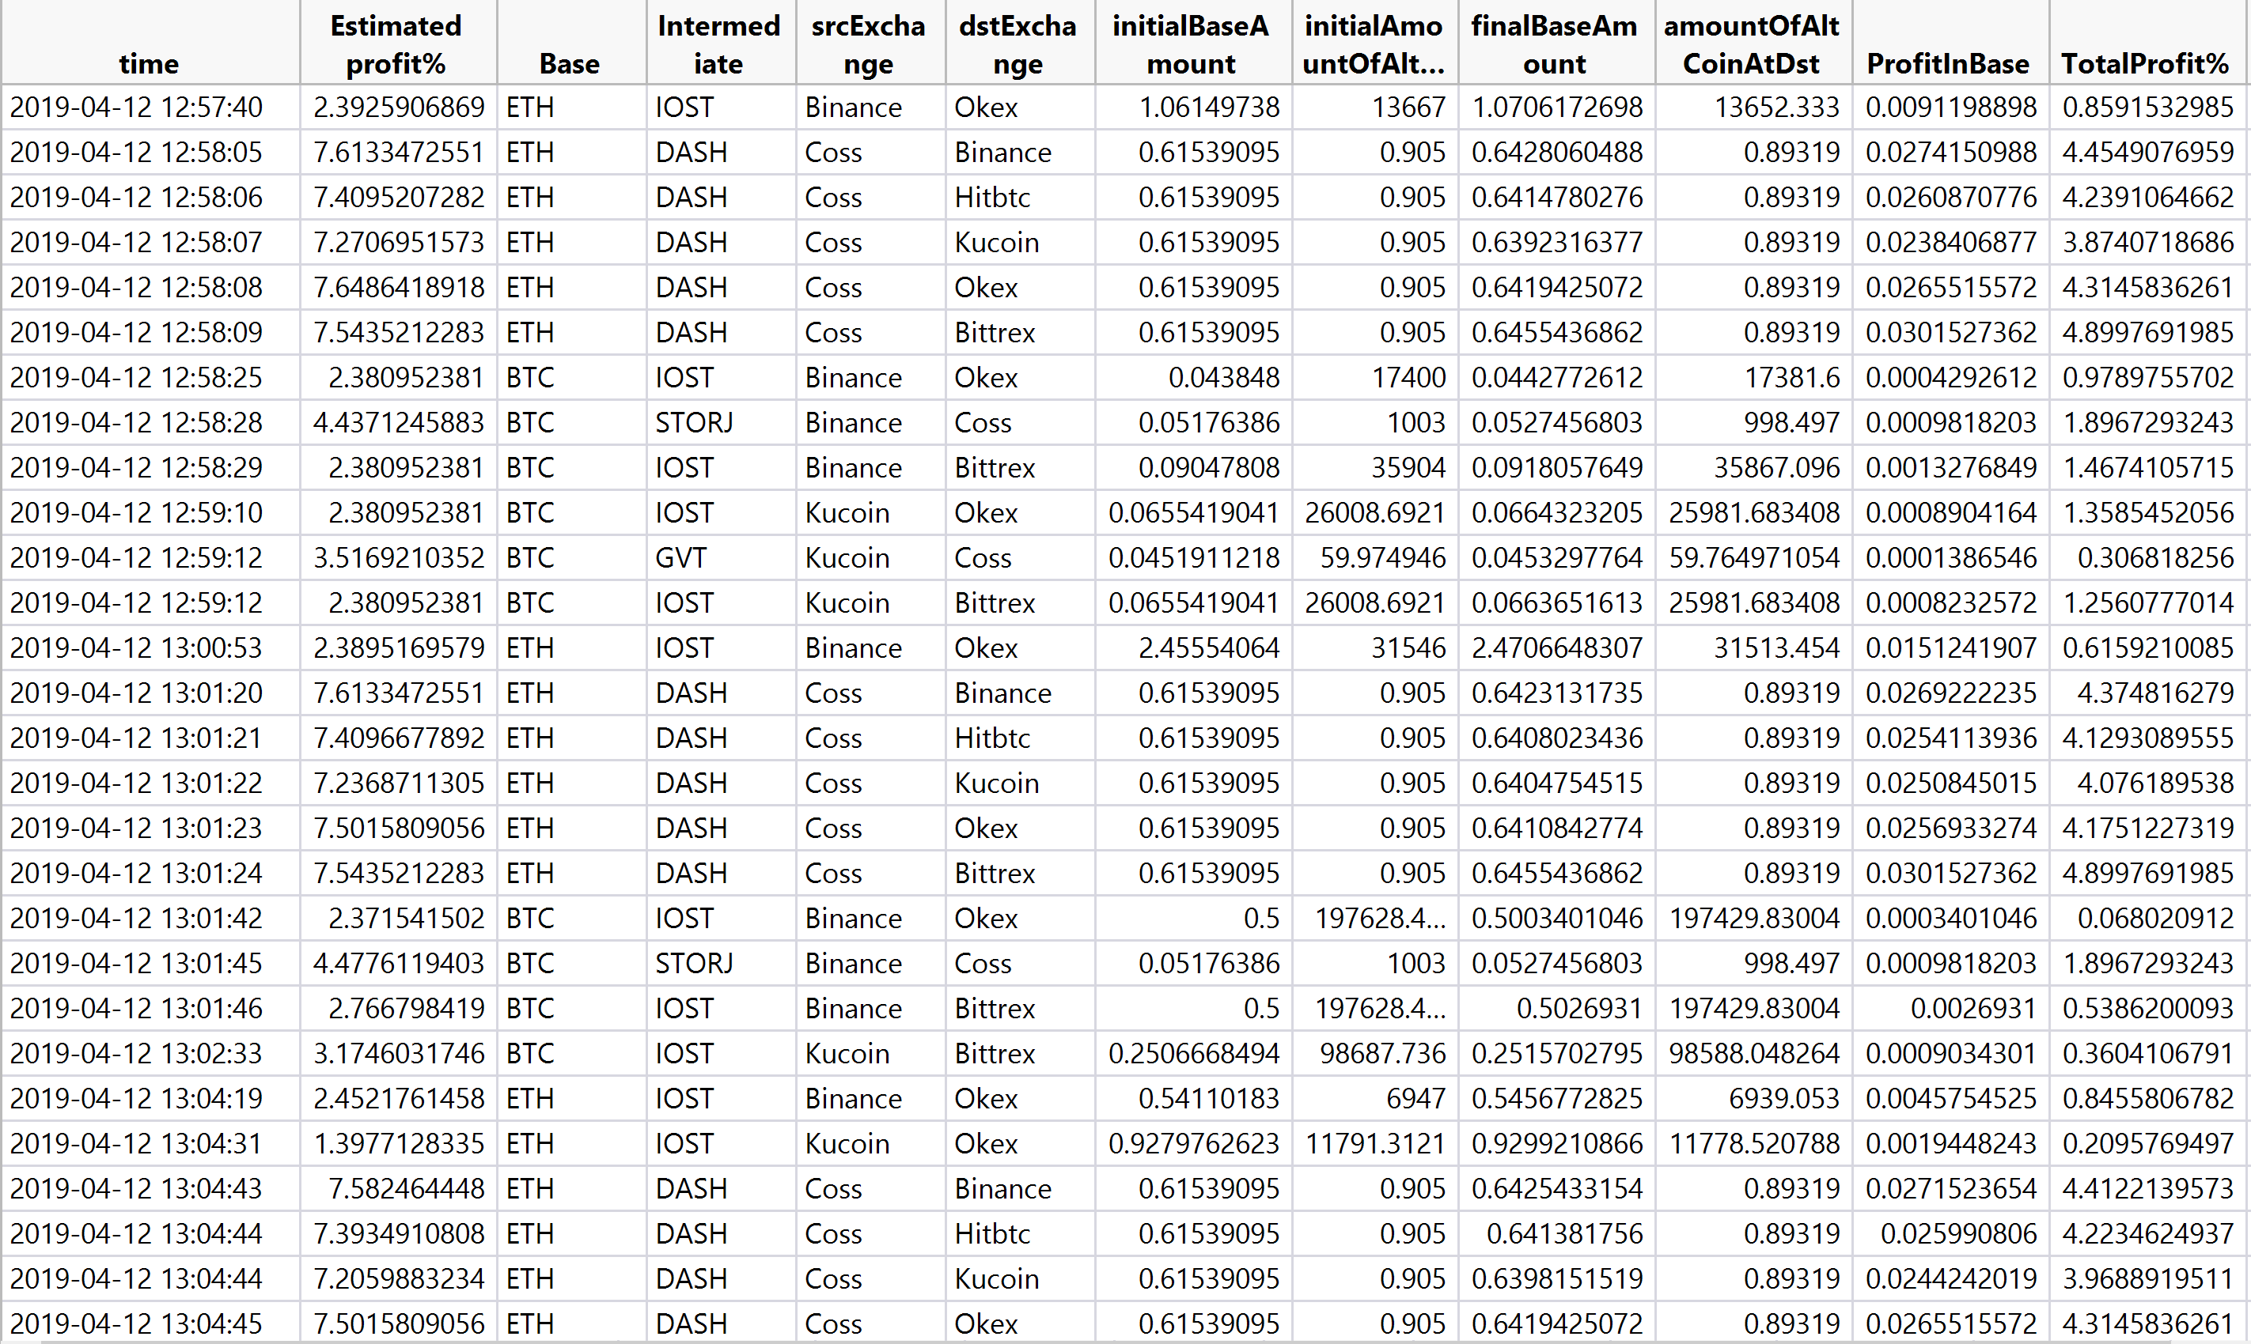

Slide 15
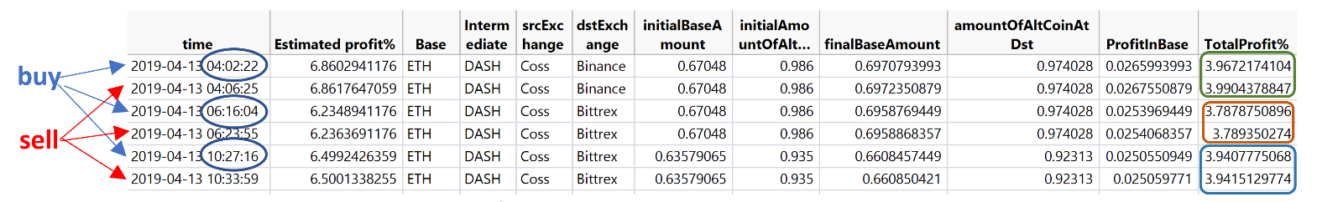
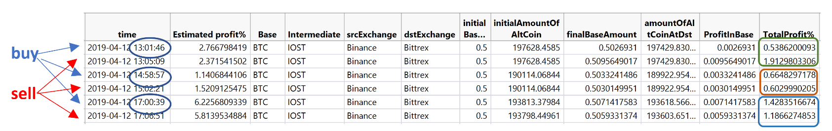
Verified profit

Slide 16
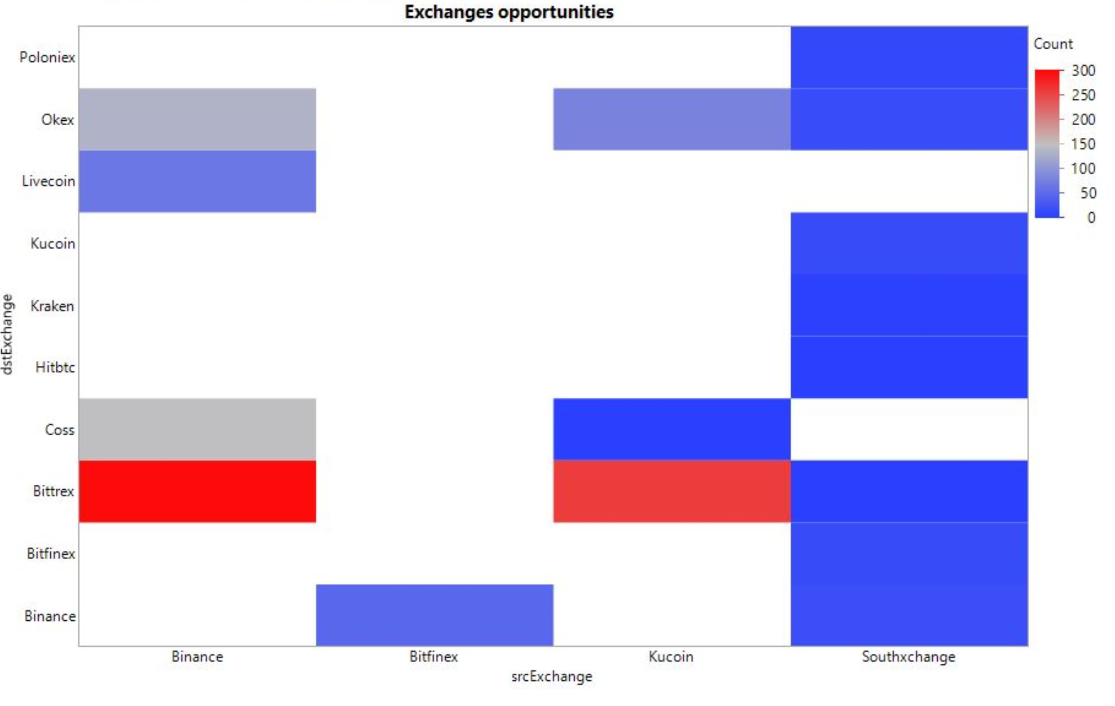
Opportunities distribution
No opportunities
Many opportunities

Slide 17
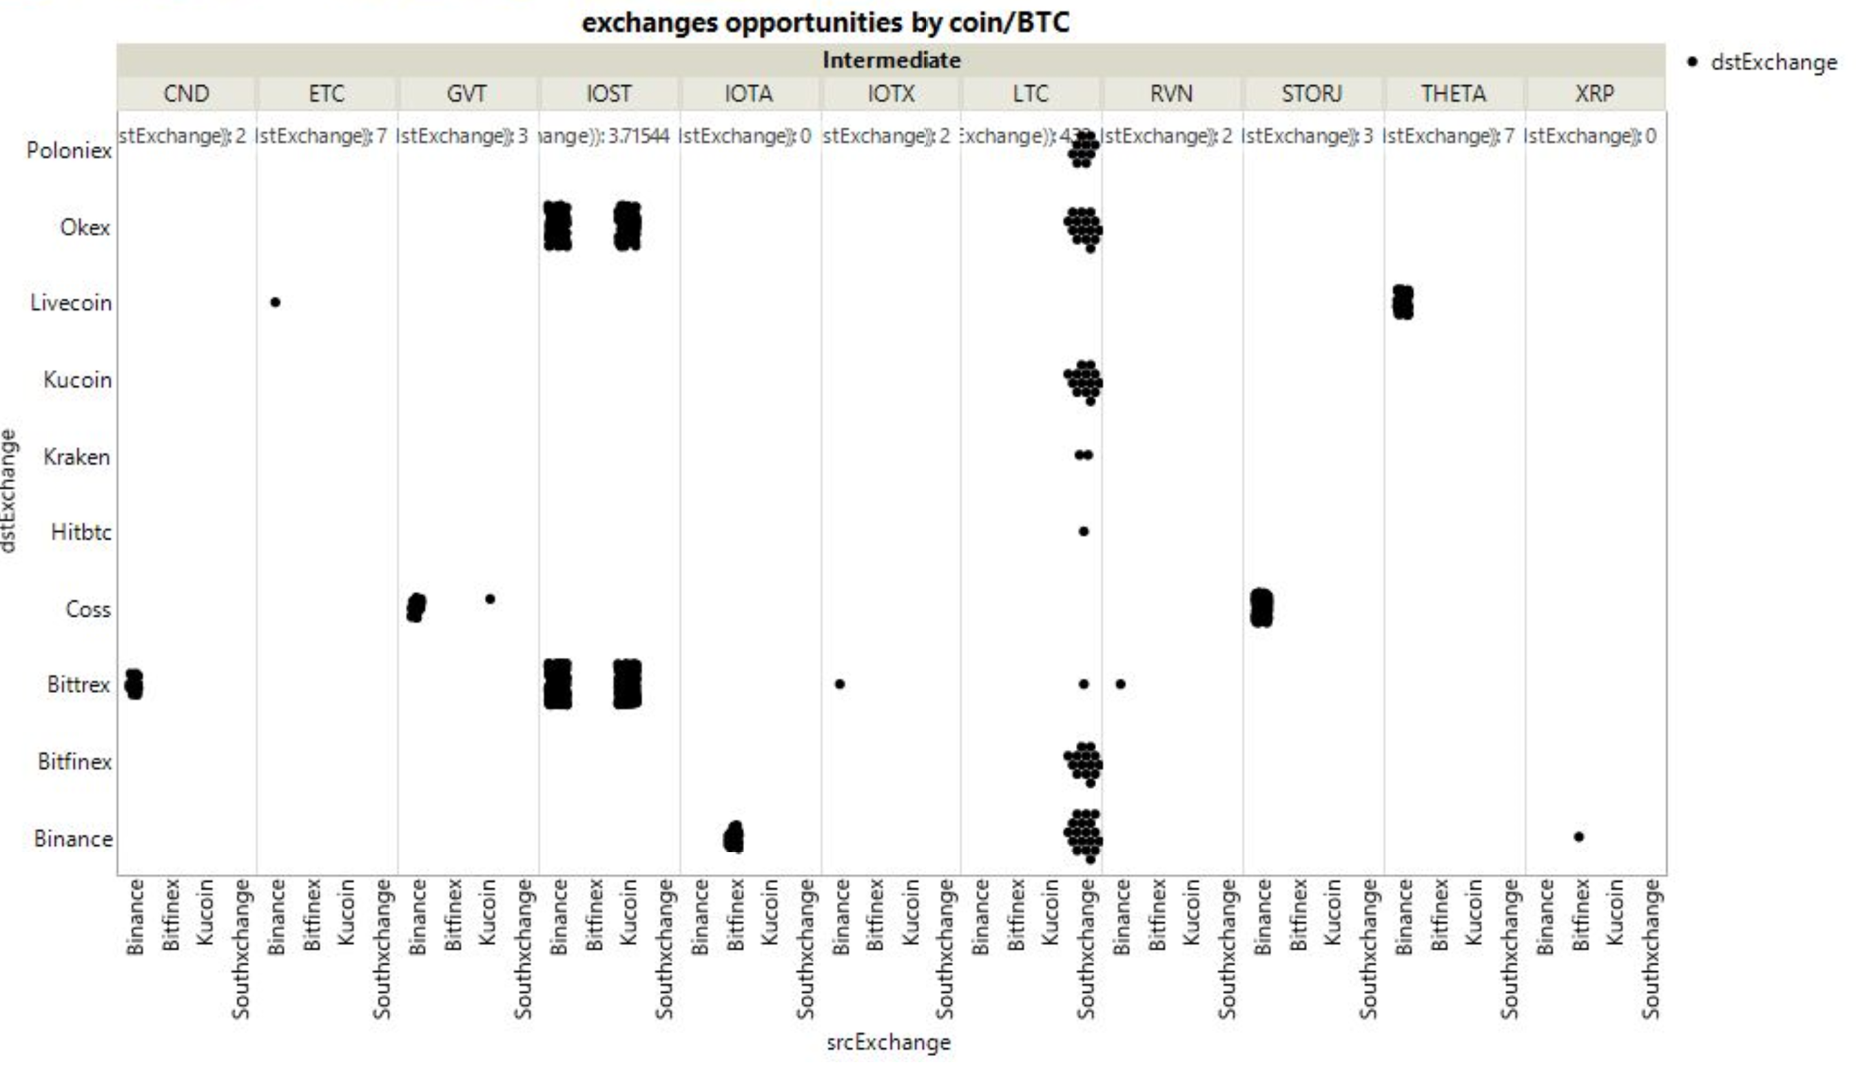
Opportunities distribution by currency

Slide 18
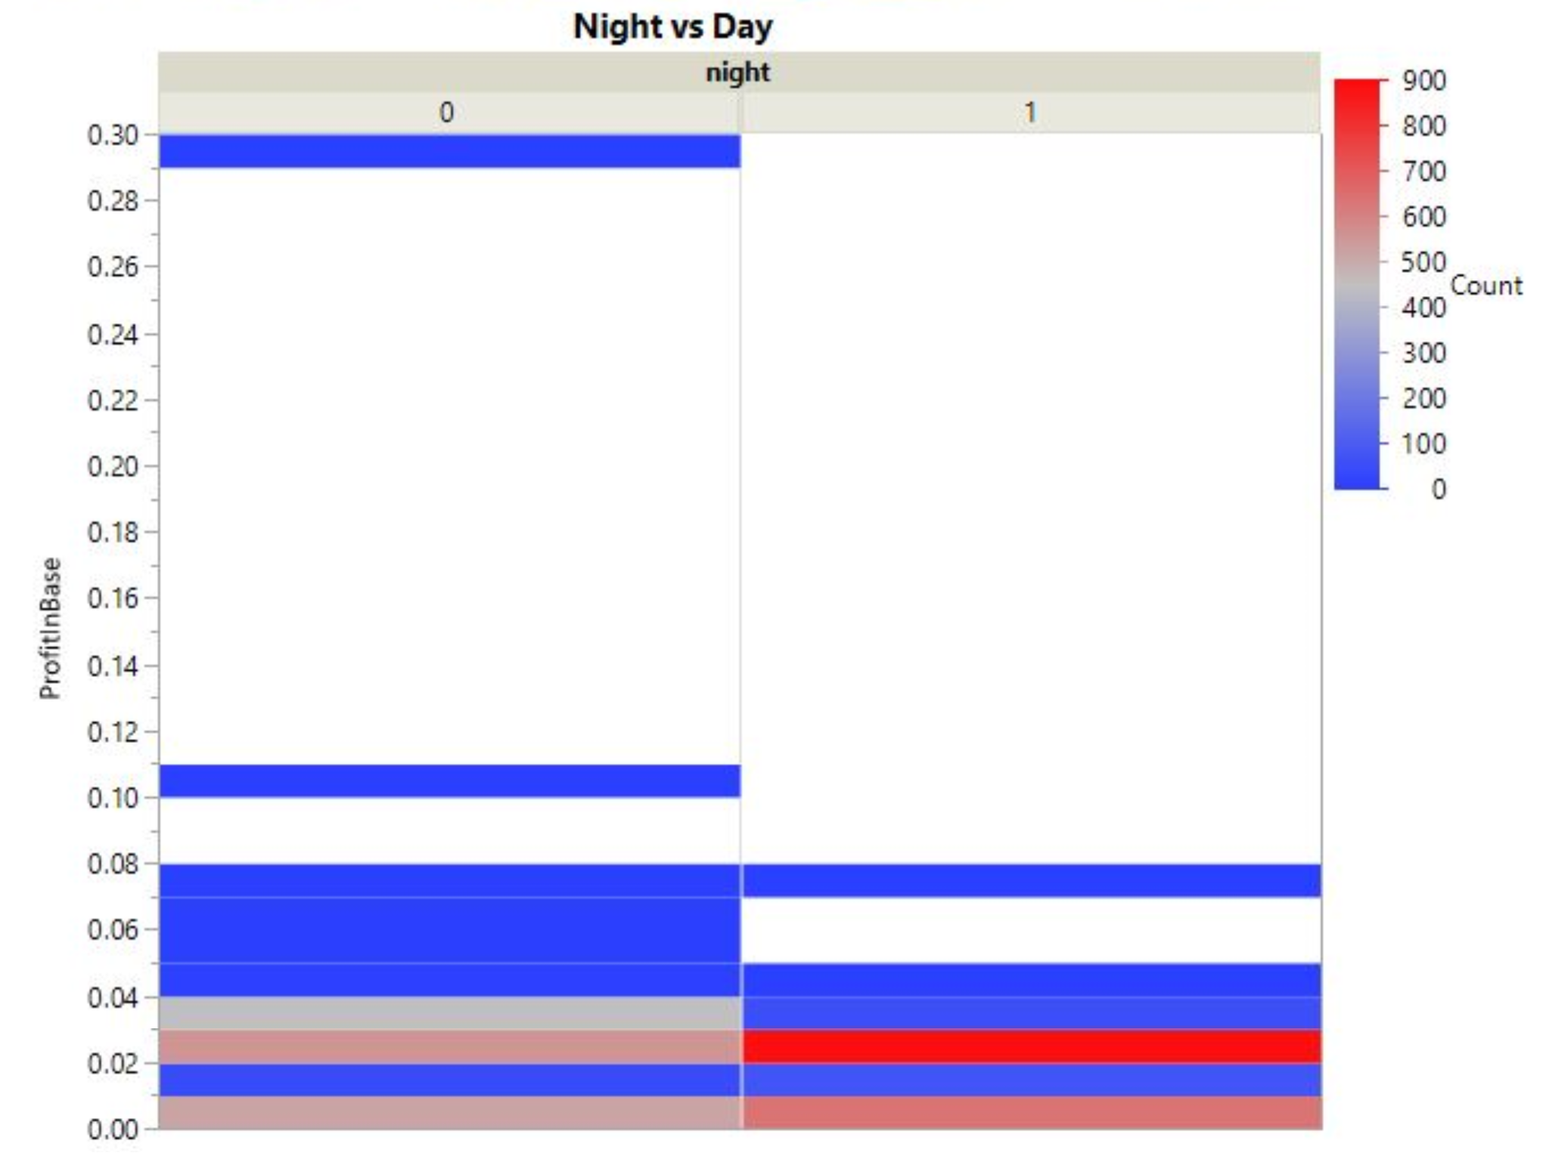
Night vs. day – number of opportunities
Day: 8:00 -20:00
Night: 20:00 – 8:00
Too good to be true
Markets more active

Slide 19
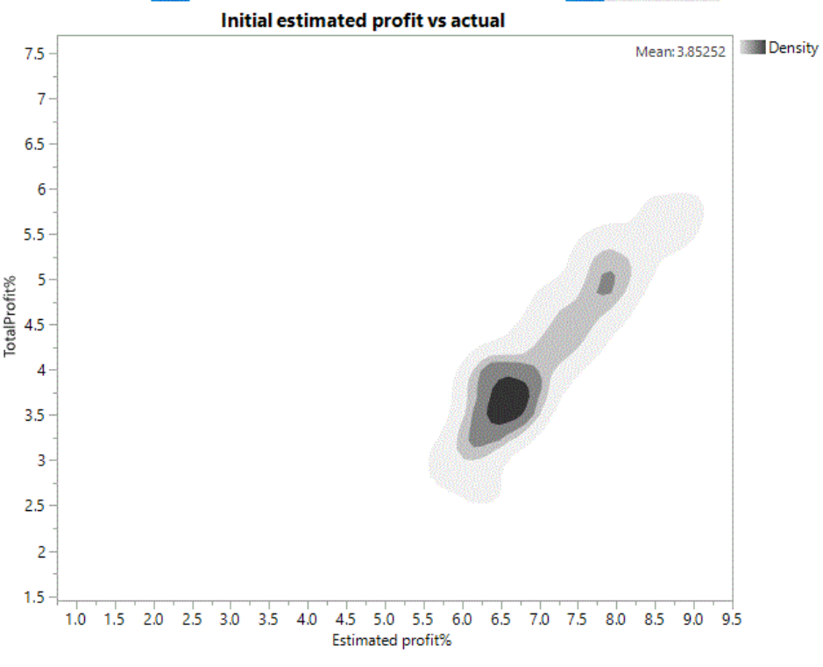
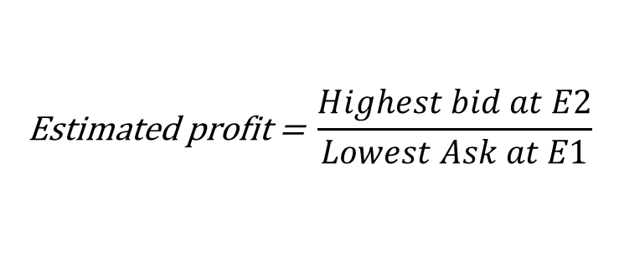
Estimated vs. real profit
$$\text{Estimated} \text{profit}\text{ = }\frac{Highest bid at E2}{Lowest Ask at E1}$$
Most profitable opportunities are ~ 3.5% profit
Estimates < 6% fail to profit
Real profit factors in:
Trading and transfer fees
Order book matching

Slide 20
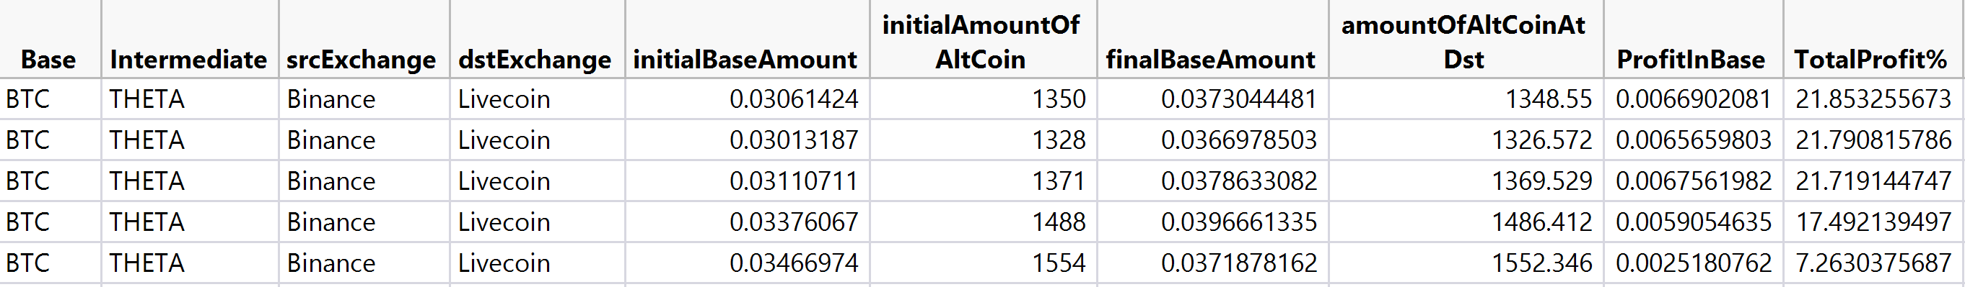
Too good to be true
The system discovered opportunities with ~21% profit!
ALERT!, further checking reveals deposits and withdrawals of THETA on livecoin are offline!

Slide 21
System architecture
Arbitrage config file
Arbitrage Engine
Output/Arbitrage opportunities
API
API
API
Coss
Binance
Bitfinex
Using CCXT library and exchanges APIs

Slide 22
Engine – max profit arbitrage
for src and dst exchanges:
for coin in coins:
estimate profit
if profit < threshold:
next coin
read order book at src and dst
perform orderbook matching to maximize profit
add fees
output opportunity

Slide 23

Summary - Challenges
Understanding arbitrage and current approaches
We did a literature review and studied papers on arbitrage.
Looked at systems built by other developers on github
Understanding exchanges structure
Communication with exchanges using APIs.
Understanding asks, bids and orderbook.

Slide 24
Summary - work
We built a directed graph and implemented BF to find Triangular arbitrage.
Low performance, neglects volume.
We developed market matching in-exchange arbitrage
Generic and scalable using ccxt library.
O(n) complexity – very fast responses.
Taker fees makes it mostly unprofitable.
Simulation showed minor loss.
EOS/BTC
ETH/BTC
EOS/ETH

Slide 25
Summary - work
Shifted focus to cross exchange arbitrage
Built a powerful generic system for cross arbitrage
Easily scalable to new exchanges and coins.
Orderbook matching solved “fake” low volume opportunities.
Developed and integrated an algorithm for maximizing opportunities
Still guarantees opportunities are not lost.

Slide 26
Summary - data analysis
Performed 24H Simulation - 3242 opportunities appeared
Profit of >7% indicate issue with an exchange – deposit/withdrawals offline.
Mean estimated profit of <6.5% tend to be not profitable

Slide 27
Thanks!! ☺
Most importantly, we enjoyed our time doing this project.
We thank Mr. Mark Levin for giving supportive supervision and the opportunity to take part in this project.
We also thank the CRML lab for hosting us.

Slide 28
BACKUP

Slide 29
Workflow
Literature review.
Playing with exchanges, understanding structure and trades.
Triangular arbitrage with Bellman Ford graph algorithm.
Triangular arbitrage with market matching algorithm.
Cross exchange arbitrage with orderbook matching and fees.
Simulation.
Data analysis.

Slide 30
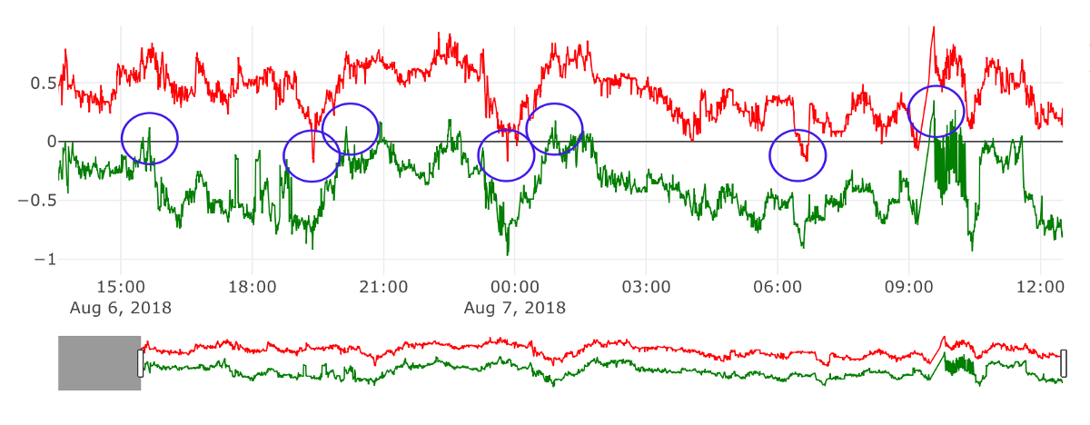
Related work – Oscillator
+ Saves transfer fees
- Complex
- Higher risk

Slide 31
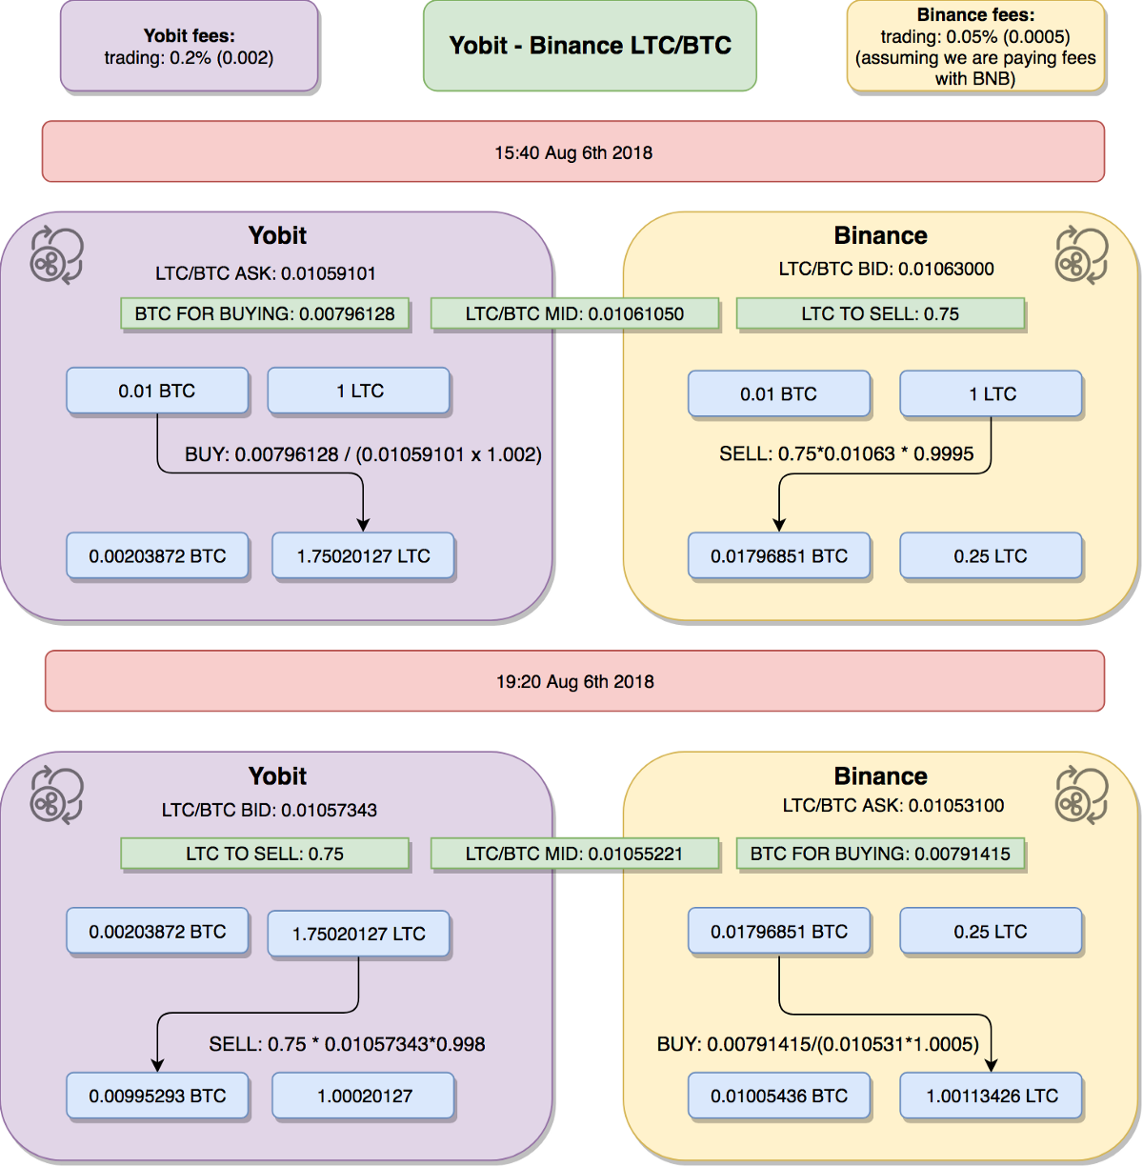

Slide 32
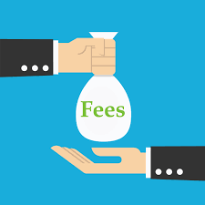
So what are the fees?
Trading fees: maker fees (0.1% - 0.25%)
Withdrawal/deposit fees (fixed, depends on currency)
Blockchain miner fees.

Slide 33
Future research and development
Improve performance by making API requests parallel with async.io.
Add and constantly update fee rates, new coins and exchanges.
Build a probabilistic model to decide on the best available arbitrages.
Check profitability of more than 3 pairs in-exchange arbitrage.

Slide 34
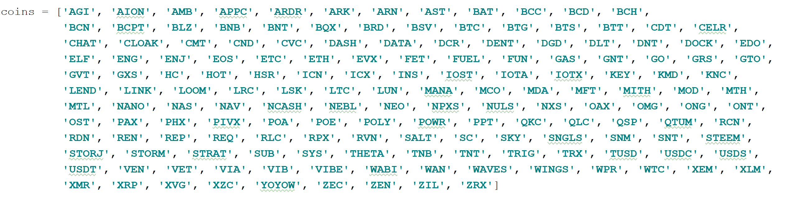
Do it yourself
Choose exchanges:
Coins:

Slide 35
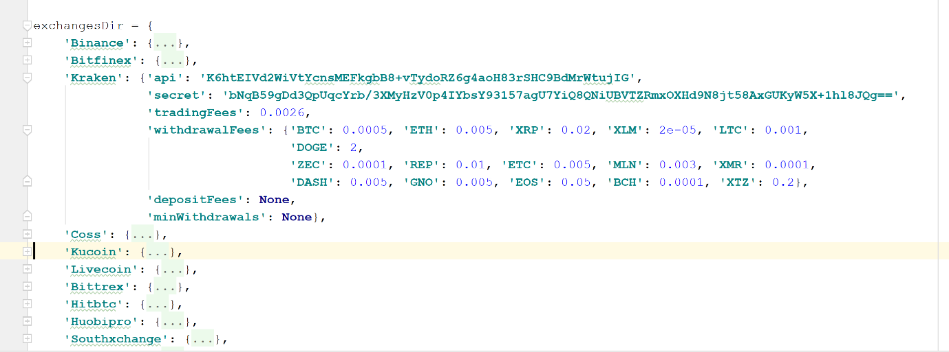
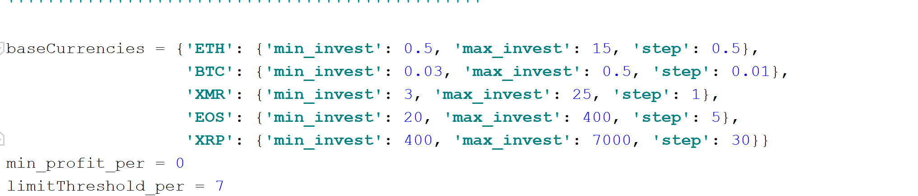
Do it yourself
Set API keys and withdrawal fees
Set base currencies and limits

Slide 36
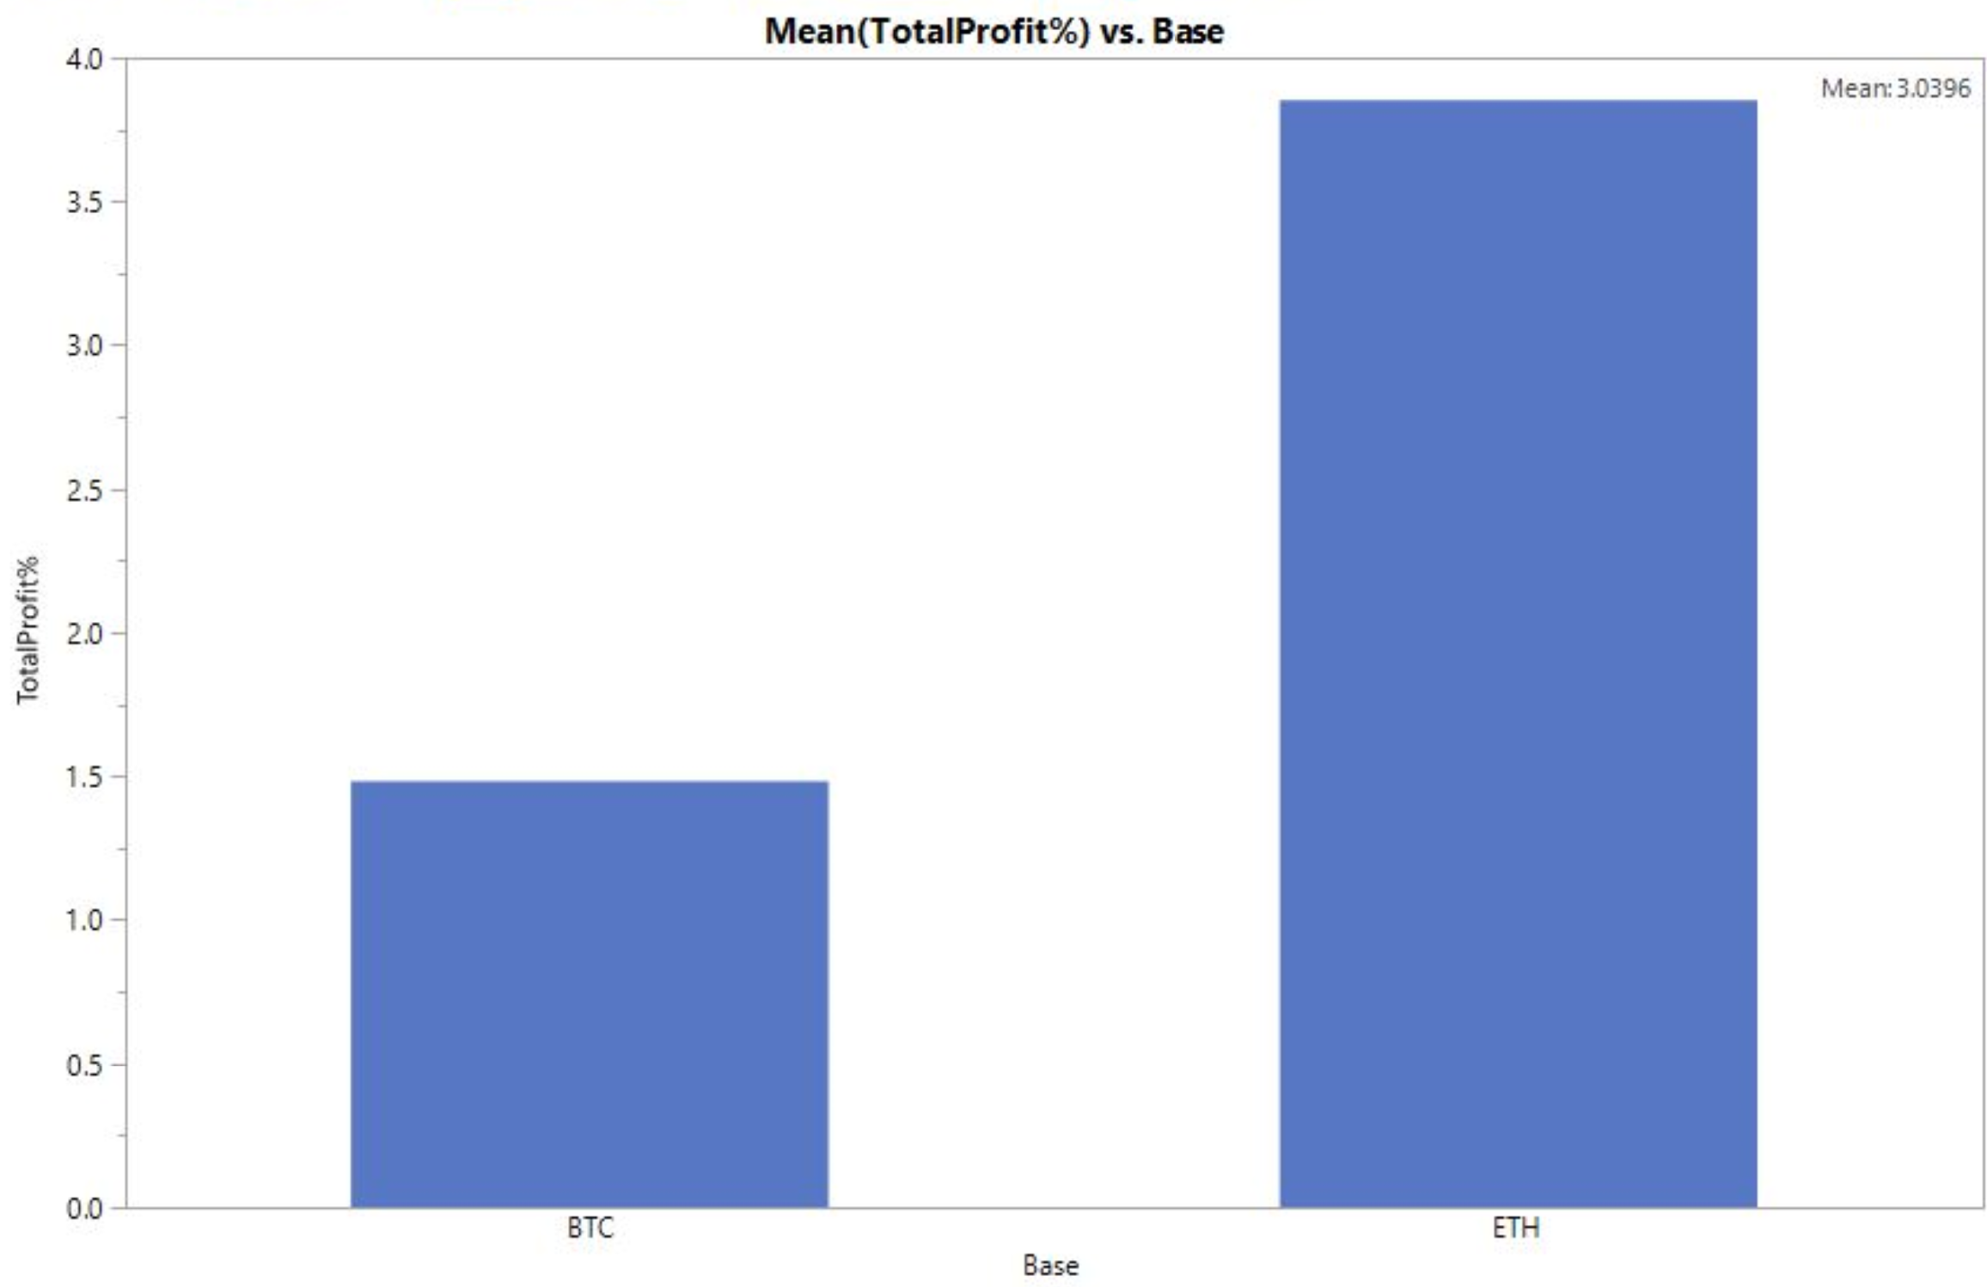
Base currency profit mean
Faster transfer: seconds vs. minutes
Lower withdrawal fees
Higher profit mean

Slide 37
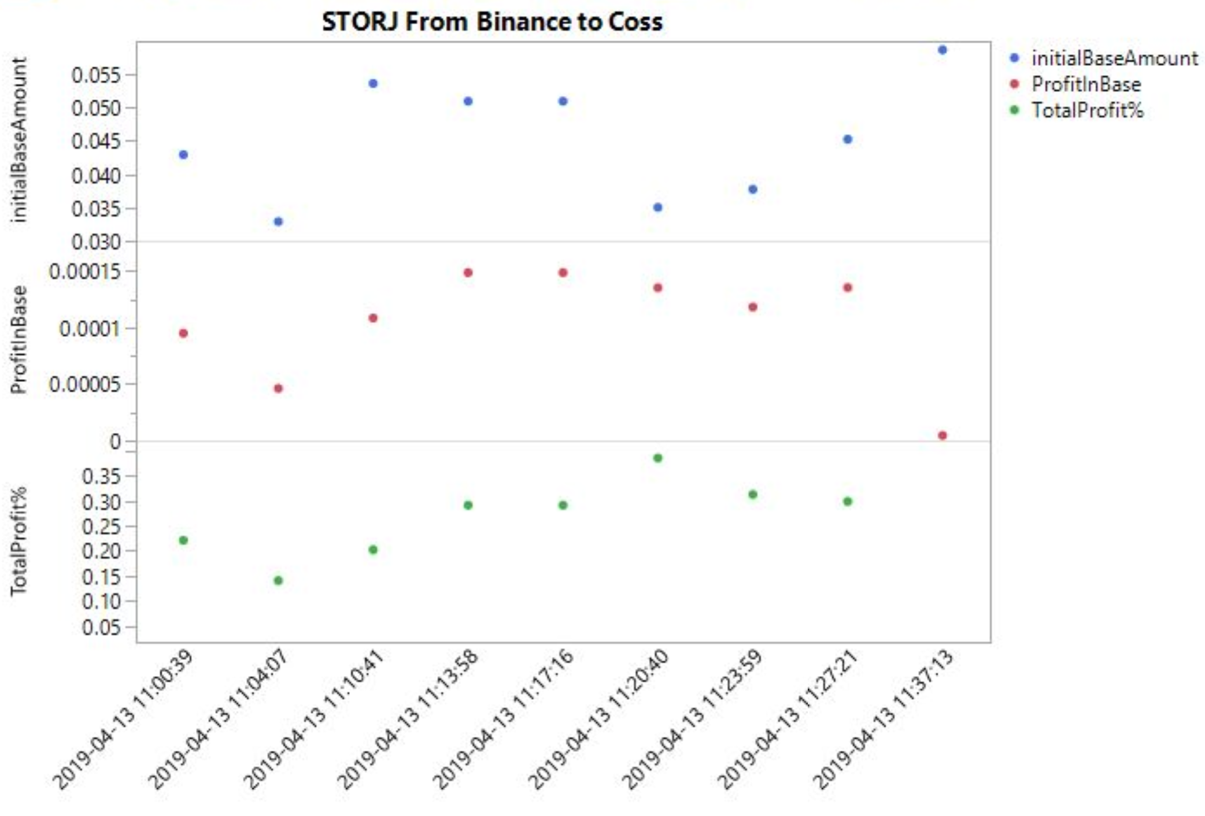
Integrity of opportunities
Part of initial arbitrage volume disappeared
37 minutes period

